Slide 1


Load Lists Revision of 20 February 2026
Dr. Norbert Doerry
http://doerry.org/norbert/MarineElectricalPowerSystems/index.htm
© 2026 by Norbert Doerry This work is licensed via: CC BY 4.0 (https://creativecommons.org/)

Slide 2
Essential Questions
What is a Load List and what is it used for? | Understand
How does one develop a load list? | Apply
How does one determine which data must be gathered? | Apply
How does one gather and manage the data? | Apply
How does one adjust a load list from a parent design? | Apply

Slide 3
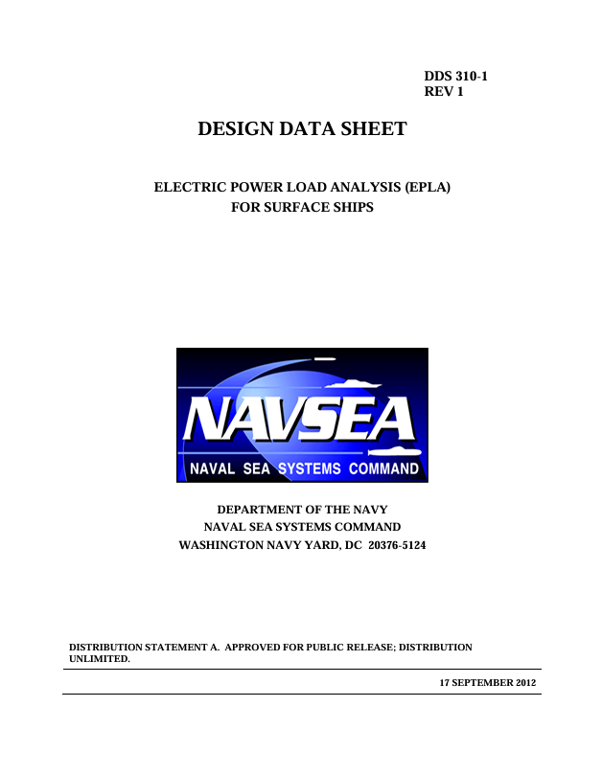
Introduction Load Lists
Tracks all electrical loads onboard the ship
Configuration managed.
Includes characteristics of the electrical loads necessary to create load models.
Should be complete
All loads should be represented by an entry in the load list.
Known loads with mostly known characteristics incorporated directly.
Loads with significant uncertainty modeled as proxy loads.
T9070-A3-DPC-010/310-1
(DPC 310-1)
(formerly DDS 310-1)

Slide 4
Proxy Loads
Represent a load or group of loads
In early stages of design, actual equipment hasn’t been determined yet.
Proxies serve as placeholders for equipment that hasn’t been defined.
Characteristics based on parametric equations, similar equipment, or scaled equipment from other ships.
Use an appropriate scaling relationship if scaling from another ship
If representing a group of loads, all the loads should connect to the power system at the same points.
Commonly done for electrical lighting and electric heaters
Proxy load definition
Should clearly state what loads are part of the proxy load.
Where possible, should identify estimated characteristics of constituent loads as well as the total proxy load roll-up.
Proxy load evolution
As the design matures, constituent loads of the proxy load are removed from the proxy load and become defined loads in the load list.
Proxy load characteristics are adjusted by removing the impact of the loads removed from the proxy load on the total proxy load roll-up.
In detail design, as equipment becomes defined, all proxy loads should be replaced with defined loads.

Slide 5
Sources of data
Master equipment list
Mission systems description and one line diagram
Electrical plant description and one line diagram
Distributed system descriptions and one-line diagrams
General/machinery arrangements
Product model (if it exists)
Discussions with system designers (if possible)
EPLAs of similar ships (if available)

Slide 6
Data Elements
Nomenclature
Product breakdown structure identifier
Location on the ship (zone and/or compartment)
Point(s) of connection to the power system (power panel, load center, switchboard).
Identification Plate (nameplate) rating (include units)
Connected load (kW and kVAR)
Peak load (kW and kVAR)
Power type (voltage, number of phases, frequency)
Load behavior
Use during different ship operating conditions
Correlation with other loads
In-rush current demand (if applicable)
Temperature dependence (if any)
Tolerance to power interruptions (for QOS analysis – if applicable)
Load shed priority (mission priority)
References

Slide 7
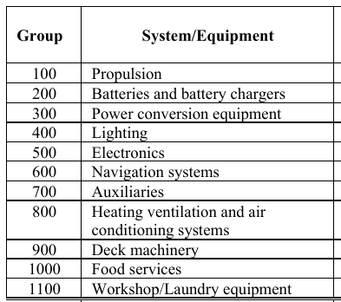
Data Elements (continued)
Nomenclature
Descriptive name of a load
Identical equipment should have the same base name followed by a unique identifier (Diesel Generator Set 1, Diesel Generator Set 2)
Product breakdown structure identifier
Used to group loads in an understandable manner (i.e. SWBS)
Location on the ship (zone and/or compartment)
Used to ensure the connection to the power system makes sense
Point(s) of connection to the power system (power panel, load center, switchboard).
Early on, may only know the switchboard connection
As the power distribution system is defined, the connection should be to the appropriate load center (and power panel)
Loads with multiple points of connection should indicate the normal and alternate points of connection.
Product breakdown structure in
IEEE Std 45.1

Slide 8

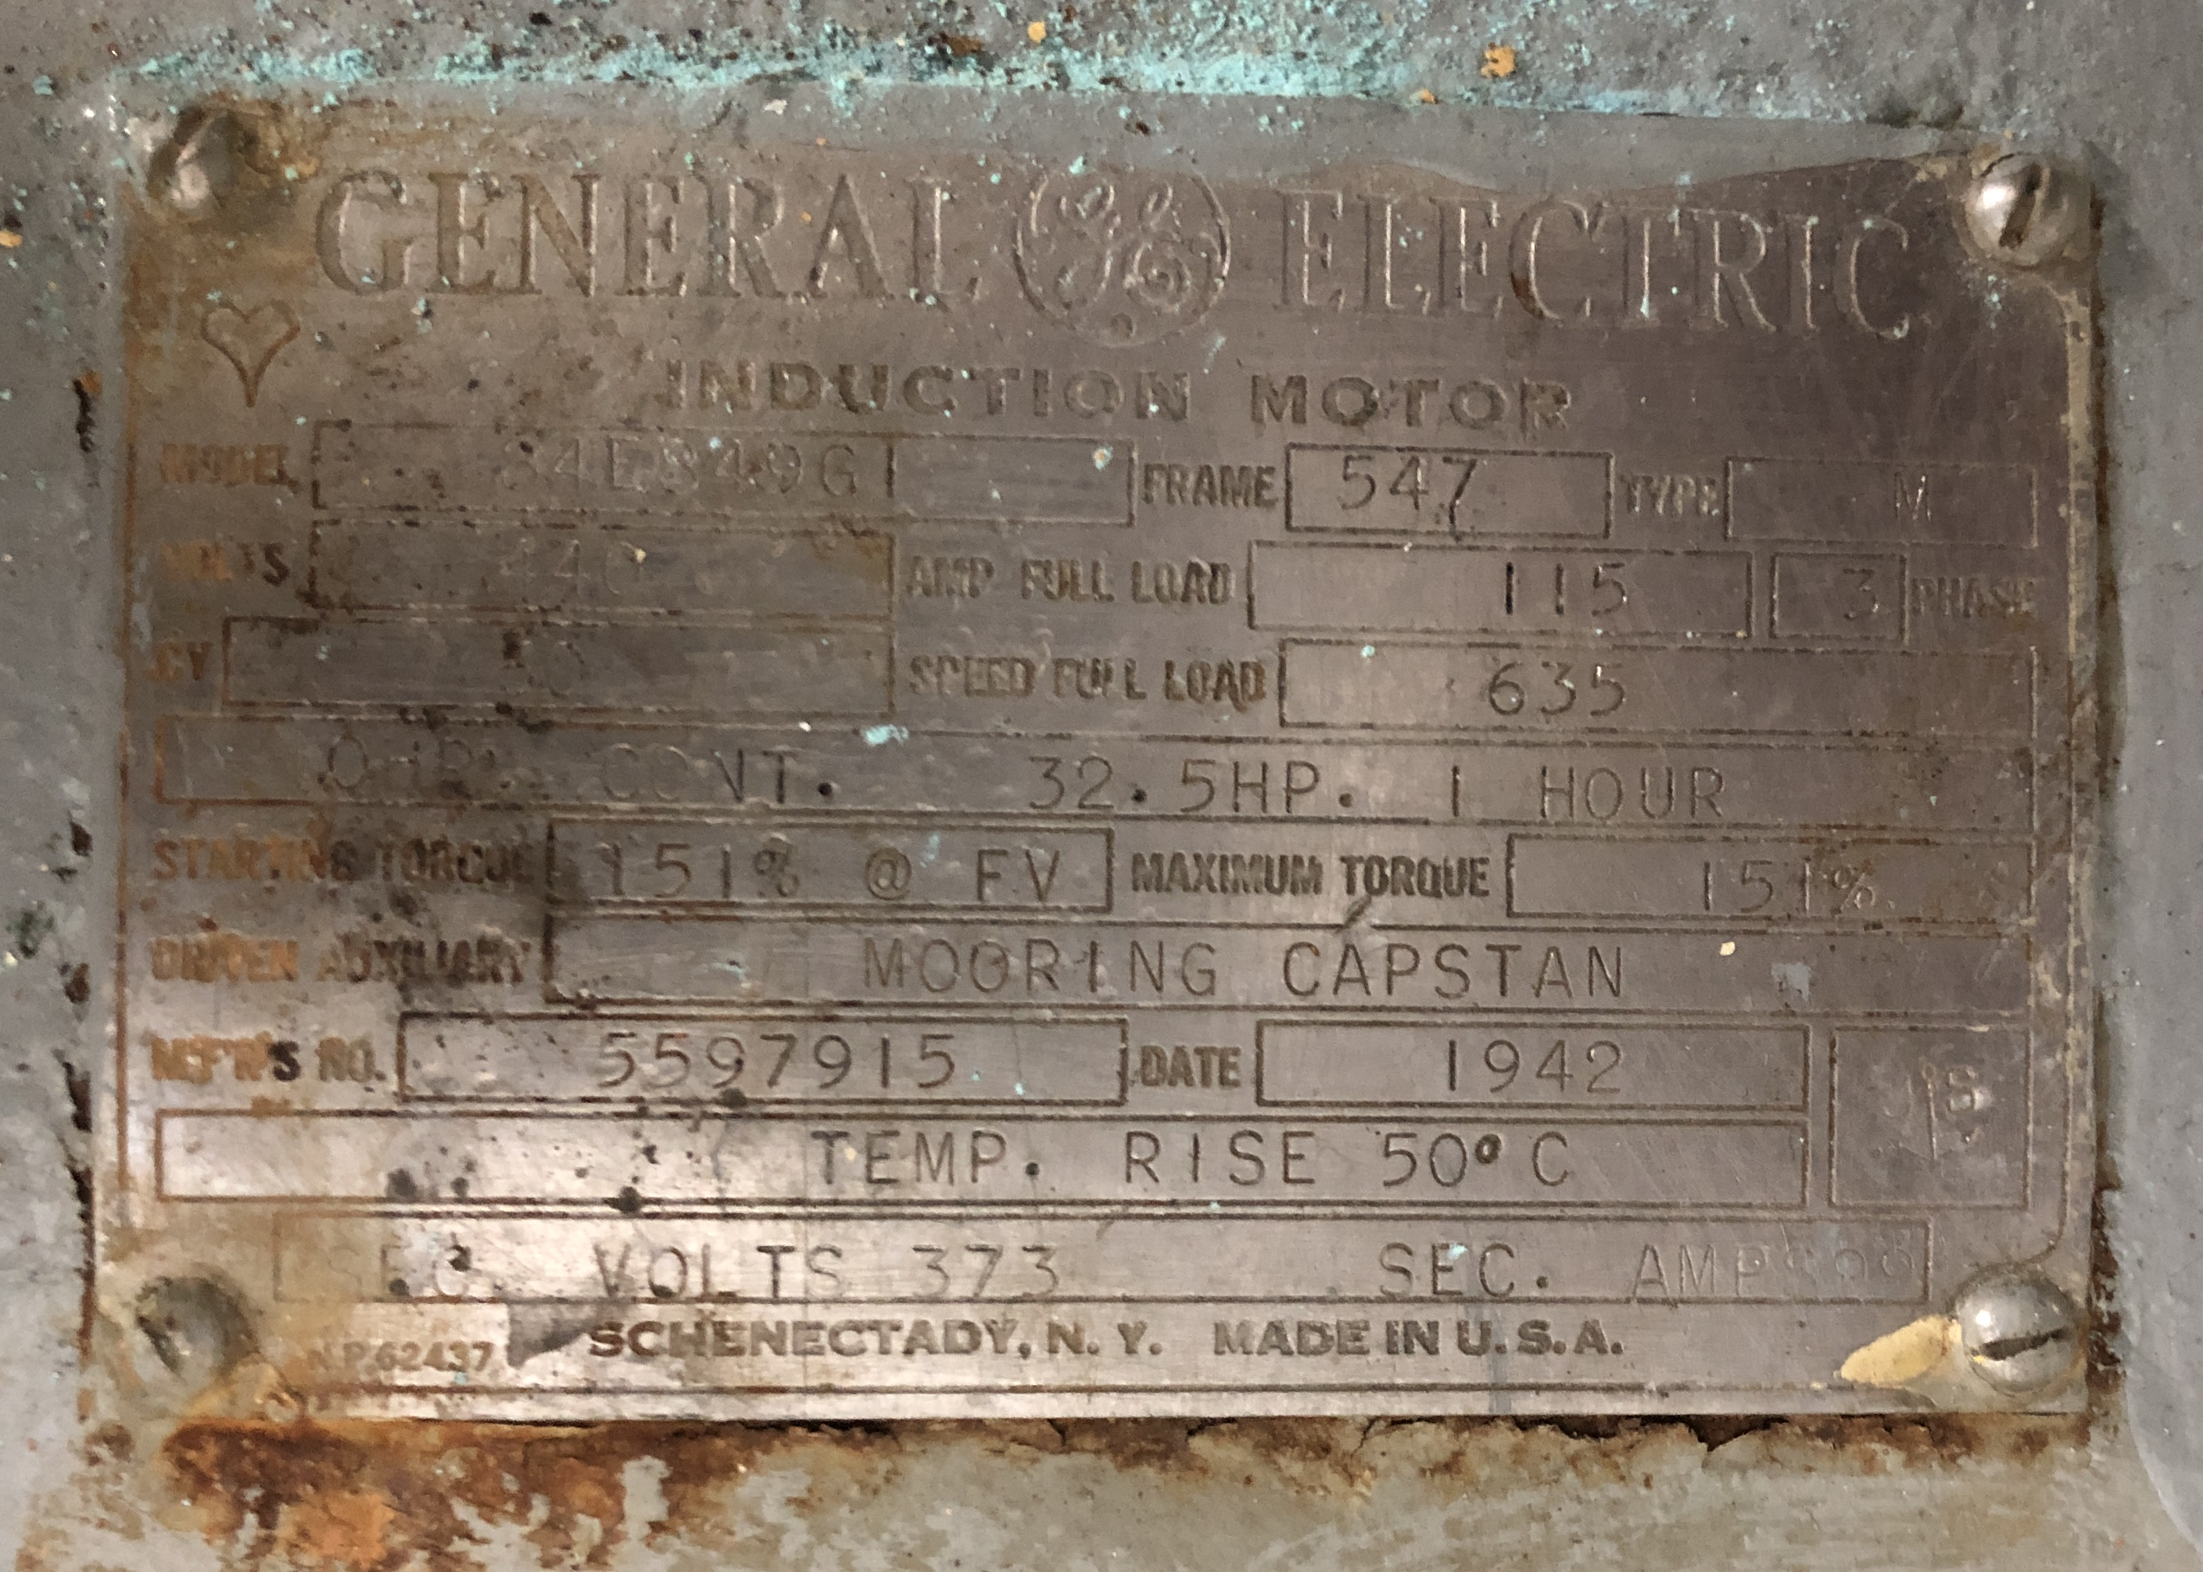
Data Elements (continued)
Identification Plate (nameplate) rating (include units)
Nameplate may have rated load in amps or mechanical hp
Connected load (kW and kVAR)
Nameplate rating converted to electrical real and reactive power (for ac systems)
Peak load (kW and kVAR)
The maximum load expected in operation
Often less than the connected load
For example: motors driving a pump
Power type (voltage, number of phases, frequency)

Slide 9

Data Elements (continued)
Load behavior
Constant: When on, load does not deviate substantially from its average value.
Multi-mode: When on, load has multiple modes, but the load does not change much while in a particular mode.
Pulsed: When on, load is a pulsed load.
Cyclic: When on, load is at its peak load for approximately a specified time, then off for approximately another specified time.
Other: When on, load characteristics are other than one of the above options.
Unknown: Load characteristics are unknown. More data gathering is required to develop a load model.
Use during different ship operating conditions
For each of the operating conditions, an indicator (typically TRUE, FALSE, GROUP, or UNKNOWN) if the load is on.
If GROUP, part of a group of loads, see Correlation with Other Loads.
If UNKNOWN, additional data gathering is required before the load is modeled.
Electric Heater
USS Wisconsin BB-64
Photo by Norbert Doerry

Slide 10
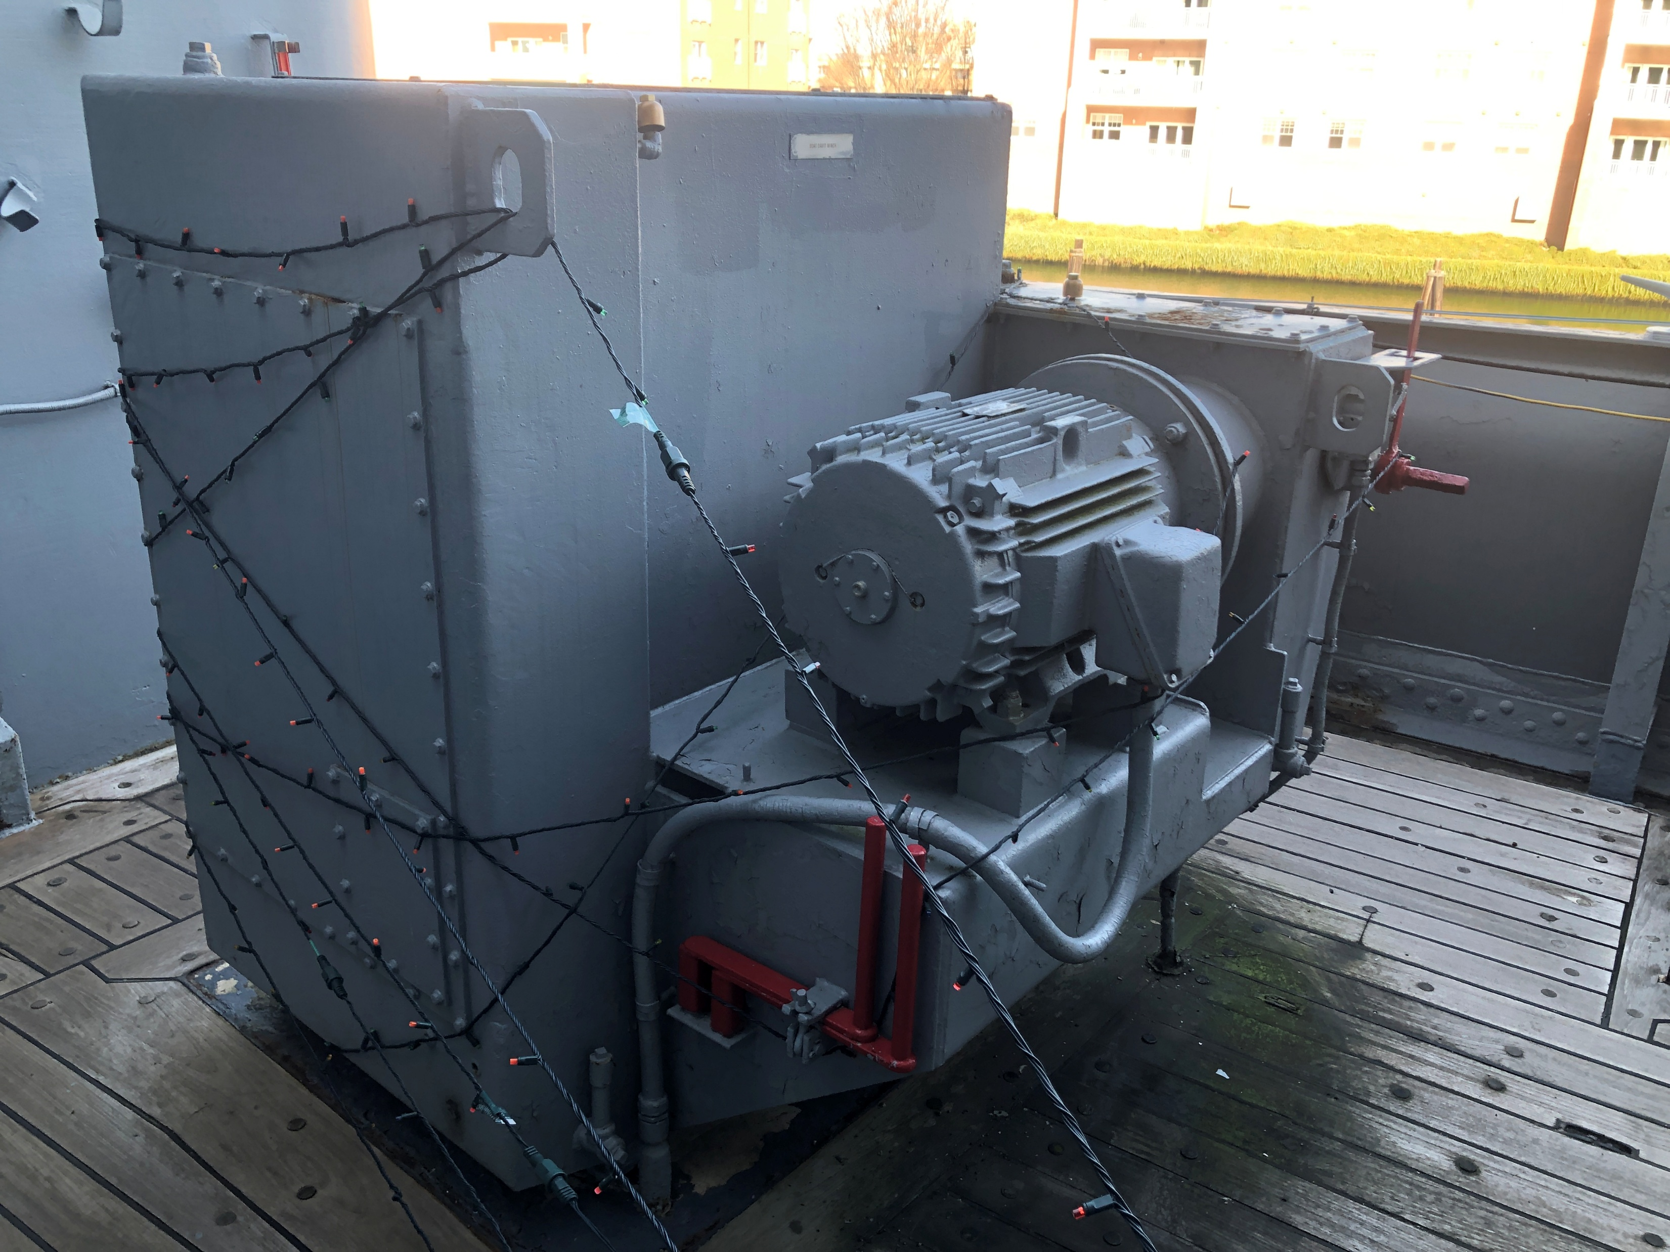
Data Elements (continued)
Correlation with other loads
Provide information with respect to how this load relates to other loads.
Possibly separately define groups of loads.
This field lists groups that the load is a member of
Rules for use of loads within a group part of group definition
In-rush current demand (if applicable)
Amount of in-rush current.
Alternately, a multiplier for the rated current.
Should also have an indicator that the load has an in-rush current, but its magnitude is not known.
Boat Davit Winch
USS Wisconsin BB-64
Photo by Norbert Doerry

Slide 11
Data Elements (continued)
Temperature dependence (if any)
Indicates if load depends on the ambient condition
TRUE, FALSE, UNKNOWN
Electric heaters typically temperature dependent
Tolerance to power interruptions
Longest power disruption that can be tolerated
Example levels
0 ms
10 ms
80 ms
0.5 ms
2 s
2 m
5 m
Unknown
Used to determine Quality of Service category
Electric Heater
USS Wisconsin BB-64
Photo by Norbert Doerry

Slide 12
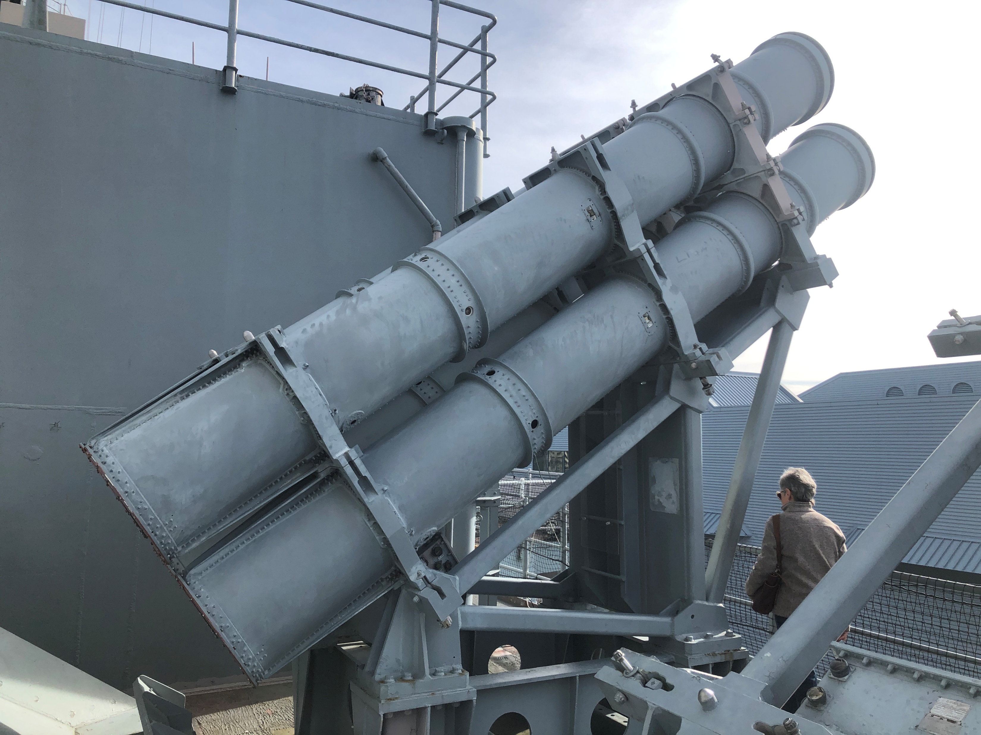
Data Elements (continued)
Load shed priority (mission priority)
At a minimum should indicate if an emergency load
Depends on mission priority load shed approach
Traditional naval combatant approach
Vital
Semi-vital
Non-vital
Dynamic mission priority load shedding enables defining different priority levels for different operational conditions
References
Each data element should reference one or more data sources
Method of obtaining the reference (such as hypertext link) should be provided
Harpoon Missiles
USS Wisconsin BB-64
Photo by Norbert Doerry

Slide 13
Managing the load list
Early in concept design
May be managed as part of a ship synthesis software tool
Extensive use of proxy loads
As design matures
Spreadsheets may be employed
Concentrate on obtaining credible data for 50 to 100 largest loads
Usually accounts for 60% to 80% of the ship’s total load
In preliminary design
Databases often used
Usually requires at least one dedicated engineer
Track down missing data
Considerable interaction with potential vendors
Considerable interaction with design team
Replace proxy loads with actual loads where possible
Develop credible estimates

